Slide 1
Formula SAE Lincoln
Drivers Meeting for Fuel, Tilt, Noise, Brake and Practice
06.21.2017

Slide 2
General Announcements
Hot Areas (appropriate behavior and attire)
Closed-toe shoes
Preferably long pants, however shorts are allowed due to hot weather
No Running
Number of team members allowed in Hot Area
4 with dynamic passes (5 for EV teams)
How to identify Event Captains?
PINK Safety Vests
Weather
Track condition/tire requirements
Emergency locations / listen for announcements

Slide 3
FUEL STATION
Hours of Operations:
Thursday 8:30am – 5:00pm
Fri & Sat 7:30am – ~4:00pm
Fuel Captain: Janice Hueske

Slide 4
FUEL STATION
Follow specific safety guidelines while in the fueling area:
No vehicles will receive fuel before passing Tech, Part 1
Until vehicles pass Tilt and receive that sticker, teams must bring the Tech sheet for approval. After passing Tilt, that is no longer required.
Vehicles headed to Tilt are allowed to be shaken, by the driver only, to free up any trapped air in the fuel system. After passing Tilt, shaking is no longer allowed.
All engines must be off; cars are to be pushed to and from fueling.
Only the vehicle push crew and the driver are allowed to enter the fueling station.
Only the driver, fully dressed in all safety gear, with vehicle fire extinguisher in hand, is permitted in the area as fuel is dispensed.
A Permanent line mark must be used to indicate the “full” level. NO TAPE
Tank is to be filled to this level each time fuel is received

Slide 5
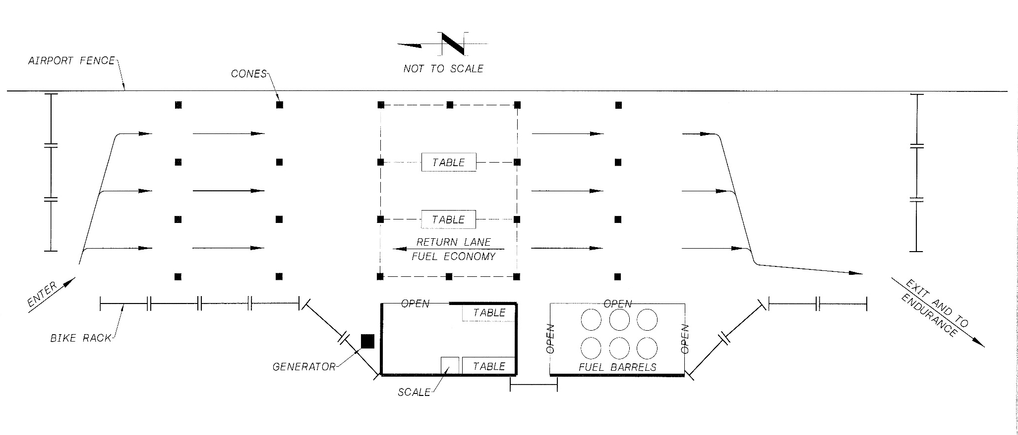
FUEL STATION LAYOUT

Slide 6
TILT TABLE
Hours of Operations:
Thursday 8:30am – 5:00pm
Friday 8:00am – 5:00pm
Tilt Table Captain: Gary Young

Slide 7
TILT TABLE PROCESS
The tallest driver aboard, fully suited, helmet buckled, gloves and all safety restraints secured.
Engine off, push car on and off table. Care must be taken to avoid damage to the vehicle when pushed on and off the tilt table.
Fuel fill side of vehicle is to be placed against the guard of the tilt table.
Vehicle will be raised to 45 degrees, and checked for leaks
Then the vehicle will be raised to 60 degrees to assure tire contact with table.
Car will be asked to exit and if passed 2nd sticker will be applied prior to leaving area.

Slide 8
NOISE TEST
Hours of Operations:
Thursday 9:00am – 5:00pm
Friday 8:00am – 5:00pm
Noise Captain: Chad Walber

Slide 9
NOISE TEST PROCESS
Vehicles may be warmed up in the warming bays with a fully suited and belted driver.
It is the teams responsibility to show the RPM via tachometer, computer or display. NO LIGHTS!
When directed, the team will push the vehicle into the test station with the car in neutral.
The team will hand their tech sheet (with engine information filled in) to the noise official who will confirm the designated test speed.
Test speed is approximately ¾ of the maximum engine speed as calculated by the SAE approved formula.
The sound level meter will be positioned 0.5m from, and level with, the exhaust outlet at an angle of 45 degrees from the outlet and be un-obstructed.
In the case of dual exhausts, both exhausts will be tested with the loudest one being the basis for judgment.

Slide 10
NOISE TEST PROCESS
Idle sound limit is 103 dBC. If team passes idle, driver will be asked to rev the engine to the target test speed.
Maximum sound level shall not exceed 110dBC (margin of error +/- .5dBC).
Official will check the kill switch with the engine at test speed.
Meters are calibrated and will be checked and verified on-site on a regular basis!
The reading of the meter by the official is final and not open for debate.
Once Passed a 3rd tech sticker will be applied.

Slide 11
BRAKE TEST
Hours of Operations:
Thursday 9:00am – 5:00pm
Friday 8:00 am – 5:00pm
Brake Captain: Ali Zangeneh

Slide 12
BRAKE TEST PROCEDURE
Driver must be wearing complete and proper safety equipment
The driver will be instructed to the start line
After starter checks the workers the driver directed to start the run
With in the brake box formed by water barriers, the vehicle must lock all 4 wheels and come to a complete stop with the engine running.
Driver will then proceed thru course and follow directions from flaggers
If vehicle needs to test again, you will be instructed to proceed back to start line and re-run the test.
If the vehicle passes the driver will be instructed to exit and turn engine OFF, the 4th sticker will be given to team and must be applied prior to leaving the area.
The Tech sheet remains with the Brake Capitan as completion notification.

Slide 13
PRACTICE AREA
Hours of Operations:
Thursday Noon – 5:00pm
Friday 8:00am – 5:00pm
Saturday 7:30am – 3:00pm
Practice Captain: Jim McNeil

Slide 14
PRACTICE TRACK – SAFETY GUIDELINES
Only one car at a time on the Practice Course or Traditional Practice Pad.
The next car will not be permitted to enter the area until the last one has completed its exit.
Three (3) volunteers (preferably four (4)) will be on hand to manage the operation of the practice areas.
Never place yourself in the line of travel of any car. Stay well away from the “hot” areas, always at a safe distance behind the barriers.
Have fire extinguishers handy.
Any vehicle damage or contact must be reported to the area (station) manager(s). Additionally, we will remove the 1st tech sticker and report car number to tech tent so car can be re-evaluated after repair.
Use of brooms and oil-dry will keep the practice areas clean and dry.
We do not permit spectators to sit or lean in the surrounding zones of the practice areas.

Slide 15
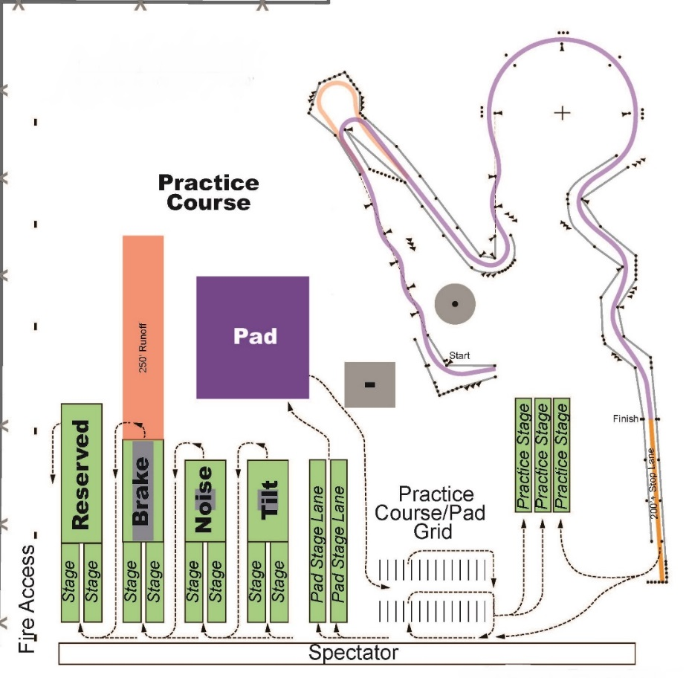
TILT, NOISE, BRAKE and PRACTICE AREA LAYOUTS

Slide 16
QUESTIONS?
Event Captains are available for questions right after this meeting.
Please clarify any unclear rules/directions at this time.

